Slide 1
User Acceptance Testing CHSP Document Management & Reporting Platform Test Objectives and Plan Created by Information Technology

Slide 2
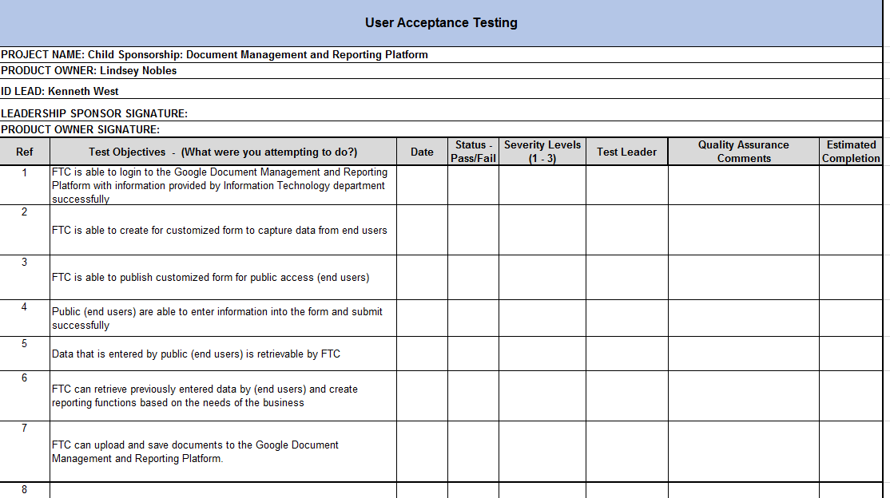
Example of Test Plan

Slide 3
What is a Test Plan?
A document that identifies test items, features to be tested, testing tasks, who will do each task, and any risks requiring contingency planning.
Our test plan will consist of three forms of communication:
Test Objectives Document
Test Incident Control Log (Basecamp)
User Sign Off Document

Slide 4
Defects and Severity Level
What is a defect?
A flaw or imperfection in a software work product or when an expected result is not matching with the applications actual result.
What are severity levels?
They define how critical the defect is with respect to the application. (1 – 3)
**Note: 1 being highest level of severity 3 being the lowest.

Slide 5
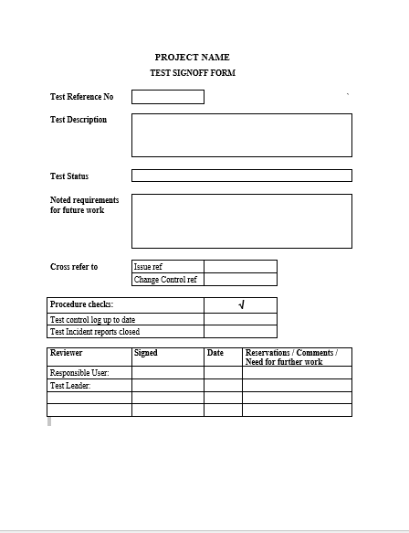
Test Sign Off
What is test sign off?
When a test is completed, it should be reviewed and formally signed off by the test leader, responsible user.
**Note: See the project’s RACI Model for Responsible stakeholders.
Why is test sign off important?
When the responsible users officially sign off on User Acceptance Testing they have agreed that the finished product is acceptable and does meet the needs of the business.
Test results should be successful and complete at sign off.
D R A F T

